Slide 1


EagleEye: Wearable Camera-based Person Identification in Crowded Urban Spaces
Juheon Yi¹, Sunghyun Choi², Youngki Lee¹
¹Seoul National University, ²Samsung Research Korea
ACM MobiCom 2020

Slide 2


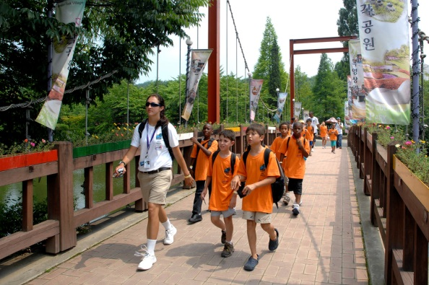
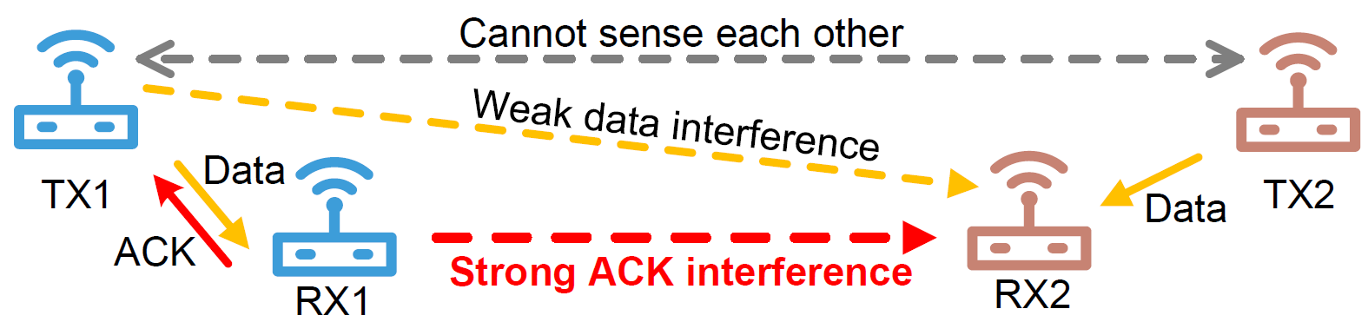
Needs for Robust Person Identification
Children counting in kindergarten field trips
Finding a crime suspect in crowded streets

Slide 3
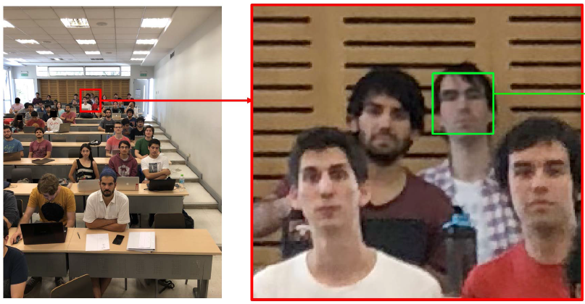
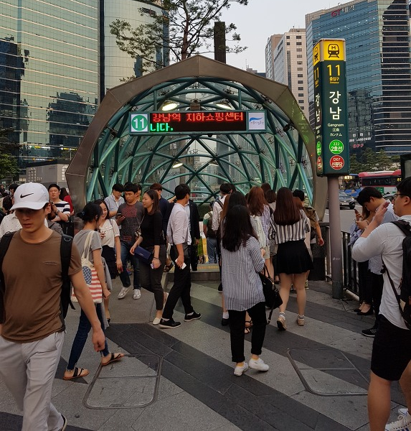
Needs for Robust Person Identification
Finding a blind date mate
Automated classroom attendance checking

Slide 4
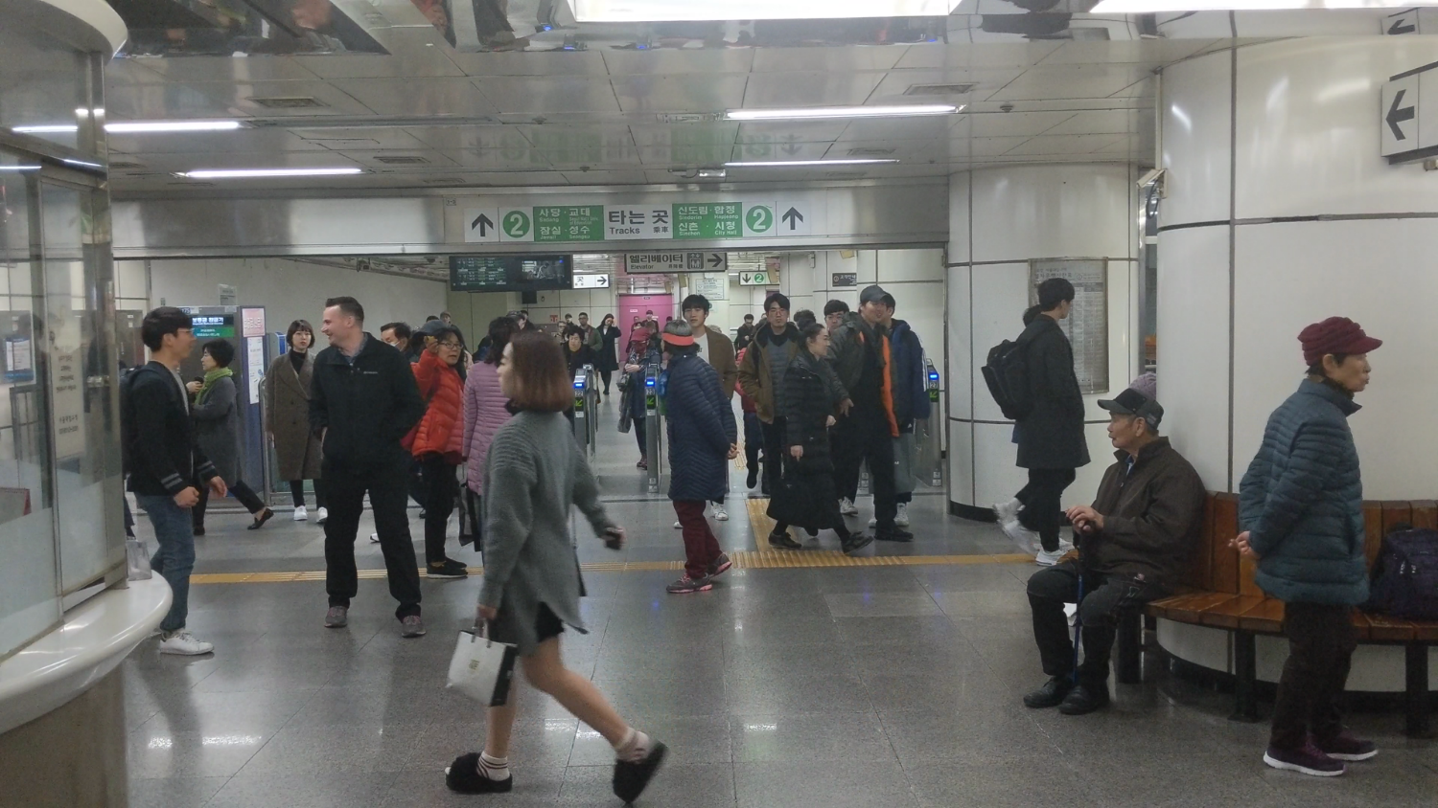

Humans: How Fast and Accurate?

Slide 5
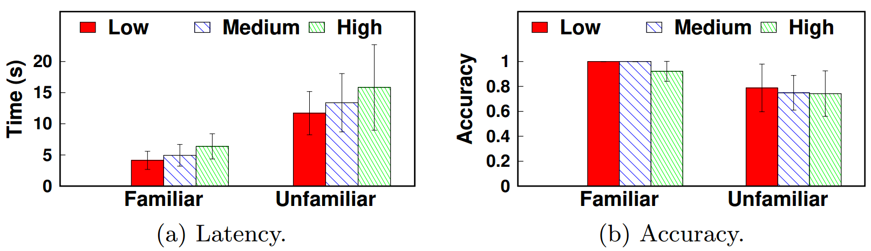
Vulnerability to Cognitive Overload
Latency/accuracy of humans finding a target person on images displayed on laptop screen
25 participants, 15 images per participant

Slide 6
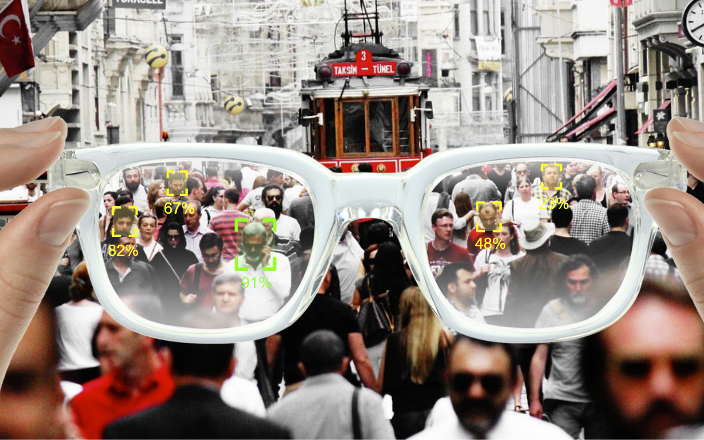
EagleEye: AR Person Identification System

Slide 7
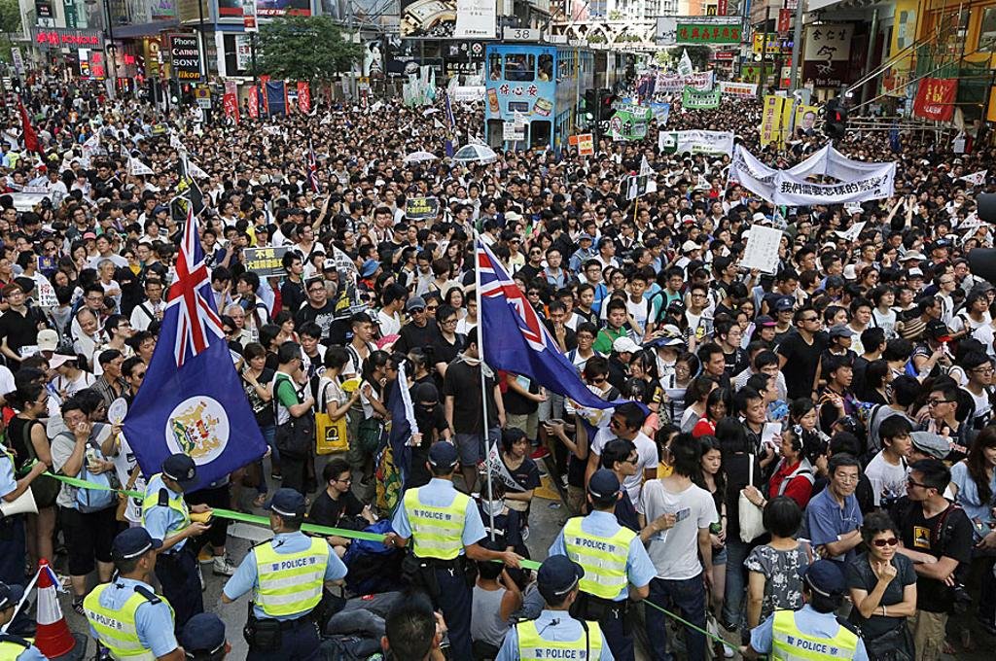
Challenge #1: Identification Accuracy
Faces captured from distance lack facial details

Slide 8
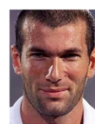

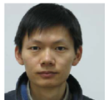
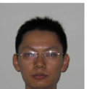


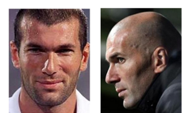
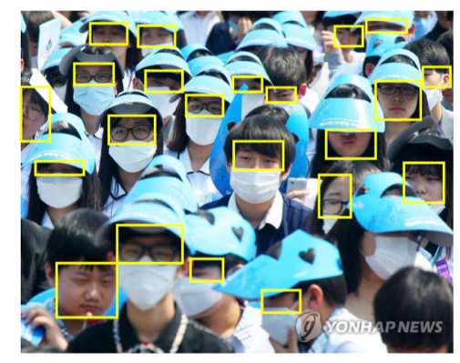
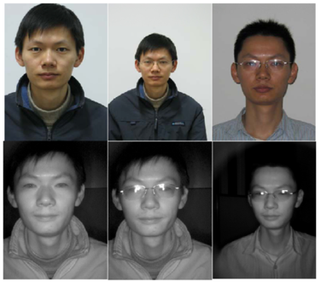
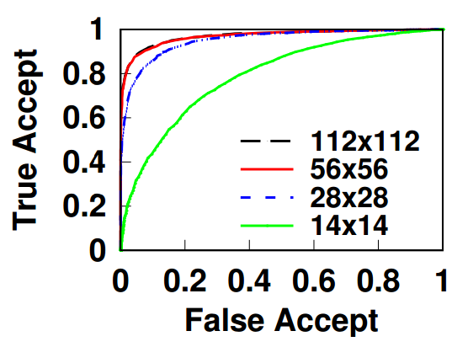
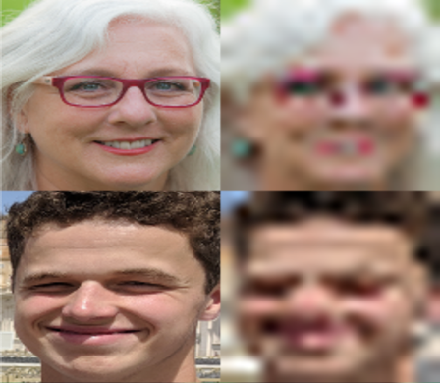

Challenge #1: Identification Accuracy
“Ideal” face recognition
Performance
bottleneck
“Unconstrained” face recognition
Pose
Occlusion
Illumination
Resolution
(* evaluated with ArcFace on VGGFace2 testset)

Slide 9
Why is LR Face Recognition Difficult?
Low resolution results in blurry decision boundaries
112x112
56x56
28x28
14x14

Slide 10


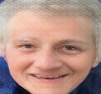




Apply Image Super-Resolution?
Conventional approaches: heavily GAN-driven
Real-looking, but can be quite different from original
LR face
GAN
Ground truth
14x14
GAN

Slide 11
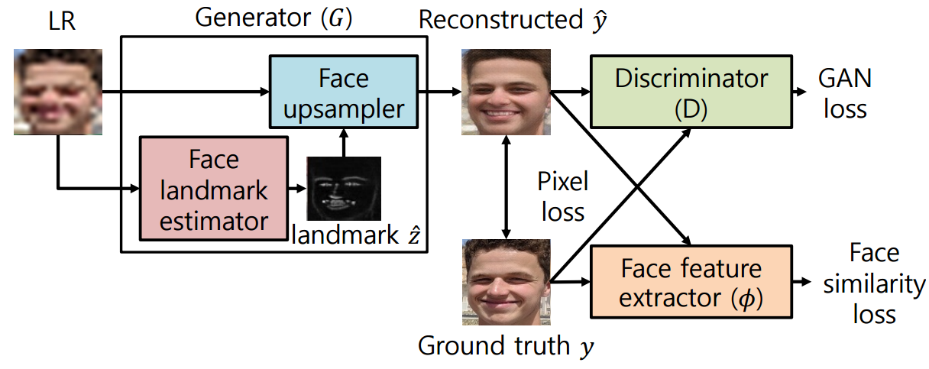
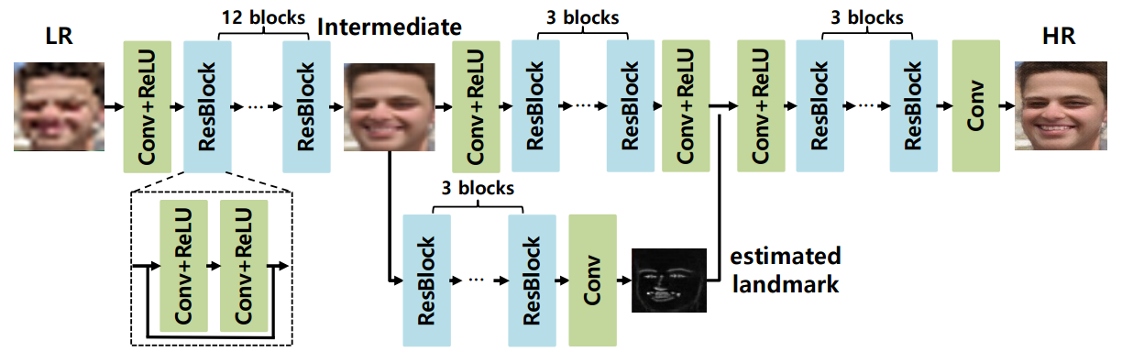
Solution: Identity Clarification Network (ICN)

Slide 12
Solution: Identity Clarification Network (ICN)
Landmark-aided HR face reconstruction

Slide 13
Solution: Identity Clarification Network (ICN)
Enforce reconstructed face to preserve facial features

Slide 14
Solution: Identity Clarification Network (ICN)
Enforce reconstructed face to be realistic

Slide 15
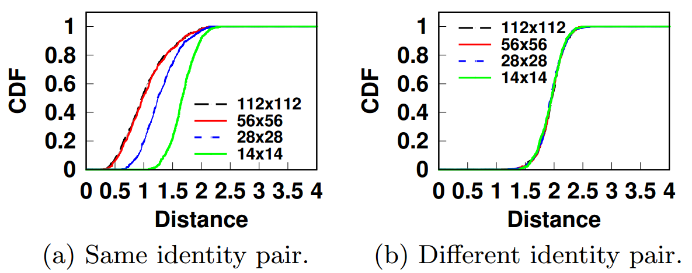
Observation for Improvements
Difficulty of LR face recognition comes from the hardship of accepting positive pair of faces

Slide 16







Identity-Specific Fine Tuning
Observation: we know who we are looking for!
Identity-Specific Fine-Tuning: fine-tune the pre-trained ICN with reference photos (probes)
Reference photos
ICN training loss
Update weights
Pre-trained ICN
Downsample
Reconstructed

Slide 17
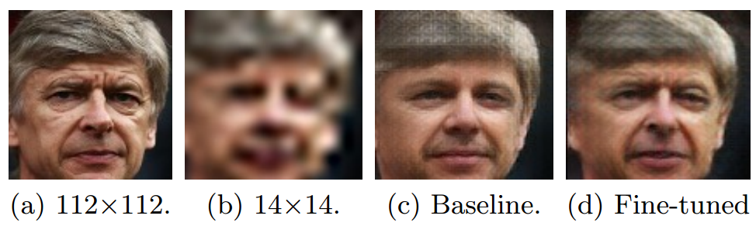
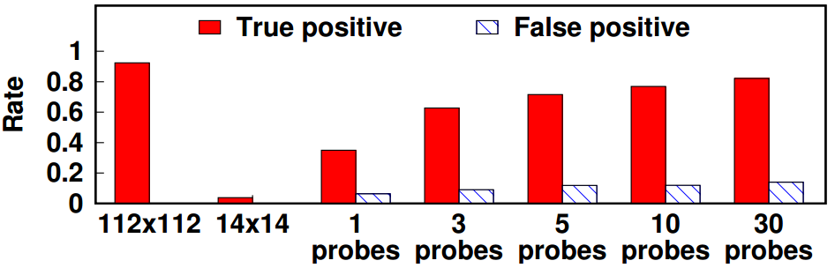
Key Evaluation Results
ICN enhances TP by 78% at the cost of 14% FP

Slide 18
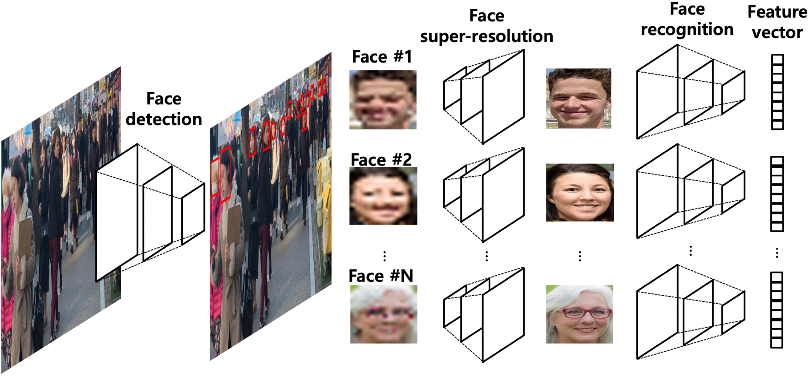
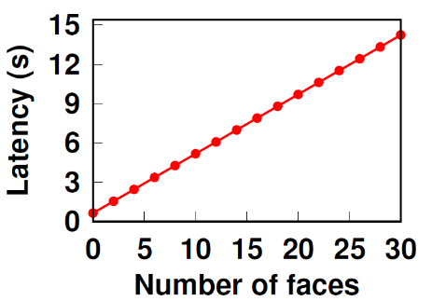
Challenge #2: Computational Complexity
Face identification: sequential execution of multiple DNNs
166 ms per face
(ICN)
287 ms per face
(ResNet50-based ArcFace [2])
648 ms per 1080p frame
(MobileNet-based RetinaFace [1])
* measured on LG V50 (Qualcomm Adreno 640 GPU) with TensorFlow-Lite
[1] J. Deng et al, “RetinaFace: Single-stage Dense Face Localisation in the wild,” arXiv 2019.
[2] J. Deng et al, “ArcFace: Additive Angular Margin Loss for Deep Face Recognition,” CVPR 2019.

Slide 19
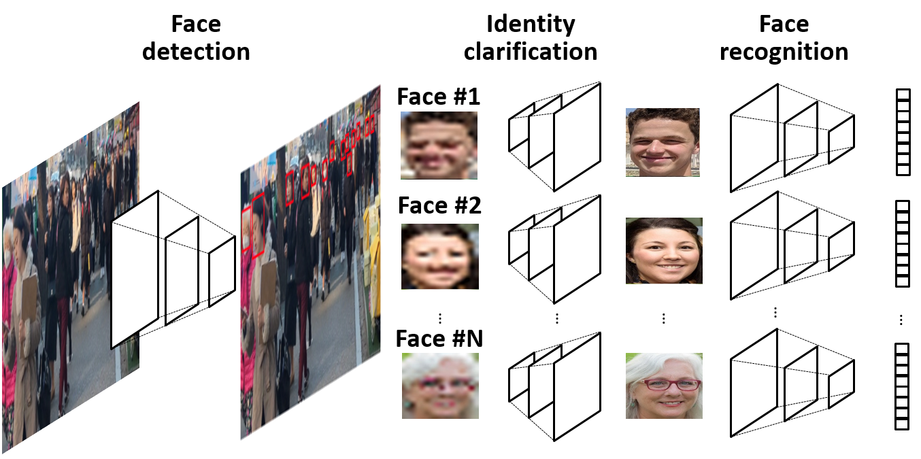
Workload Characterization
High-resolution input
Sequential & repetitive execution of multiple DNNs

Slide 20
Optimization Strategies
High-resolution input
→ Parallel execution
Sequential & repetitive execution of multiple DNNs
→ Content-adaptive pipelining

Slide 21
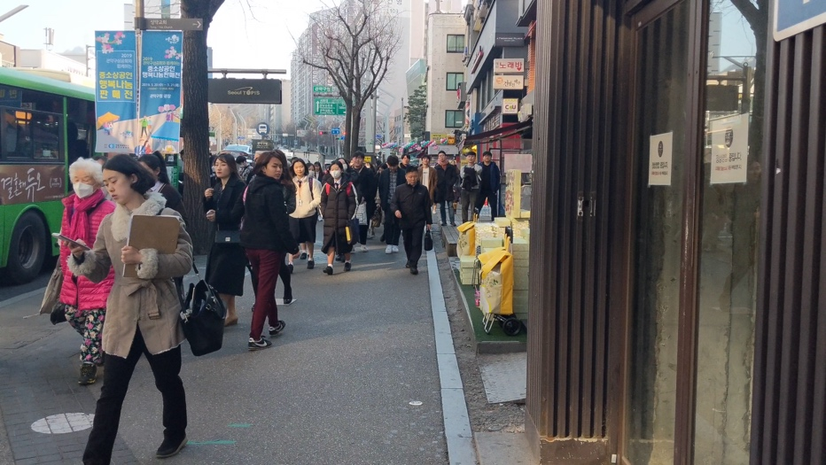

Content-Adaptive Parallel Execution
Operational flow in a nutshell
① Background → Excluded from processing
② Large, frontal faces → Detection + lightweight recognition
③ Large, profile faces
→ Detection + heavy recognition
④ Small faces
→ Detection + ICN + heavy recognition
④
①
③
②

Slide 22
Edge-Based Background Filtering
Edges give a loose hint on where faces would be → Save unnecessary computation
Edge detectors run in real-time (e.g., 2 ms)
Save 64% of computation!

Slide 23
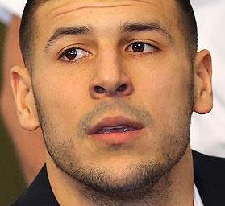
Variation-Adaptive Face Recognition
Recognition difficulty varies heavily on face variations
Choosing the “right” pipeline is crucial!
Easy
Hard
Model | Inference time | LFW (easy faces)
MobileFaceNet | 14 ms | 98.9%
ArcFace | 287 ms | 99.3%
overkill!

Slide 24
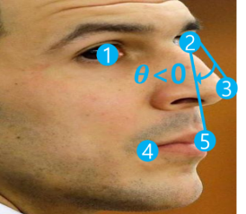
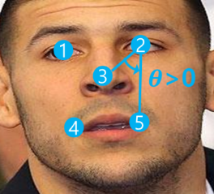
Variation-Adaptive Face Recognition
How do we determine the “right” pipeline?
Is the resolution sufficient?
No
Yes
Is the pose frontal?
No
Yes
ICN + ArcFace
ArcFace
MobileFaceNet

Slide 25
Execution Planning
① Background → Excluded from processing
② Large, frontal faces → Detection + lightweight recognition
③ Large, profile faces
→ Detection + heavy recognition
④ Small faces
→ Detection + ICN + heavy recognition
④
①
③
②
DNNs to execute
RetinaFace
ICN
ArcFace
MobileFaceNet
Available processors
Mobile CPU
Mobile GPU
Cloud GPU
How can we map the two?

Slide 26
Execution Planning
High-resolution image
Large GPU memory I/O latency
Incurs high network bandwidth consumption

Slide 27
Execution Planning
High-resolution image
Mobile CPU

Slide 28
Execution Planning
High-resolution image
Mobile CPU
Proportional to number of faces
166/287 ms per face on mobile GPU
6.1/7.5 ms per face on cloud GPU

Slide 29
Execution Planning
High-resolution image
Mobile CPU
Proportional to number of faces
Local GPU: MobileFaceNet
Cloud GPU: ICN + ArcFace

Slide 30
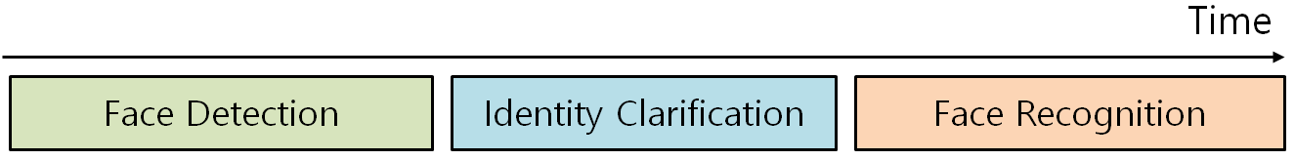
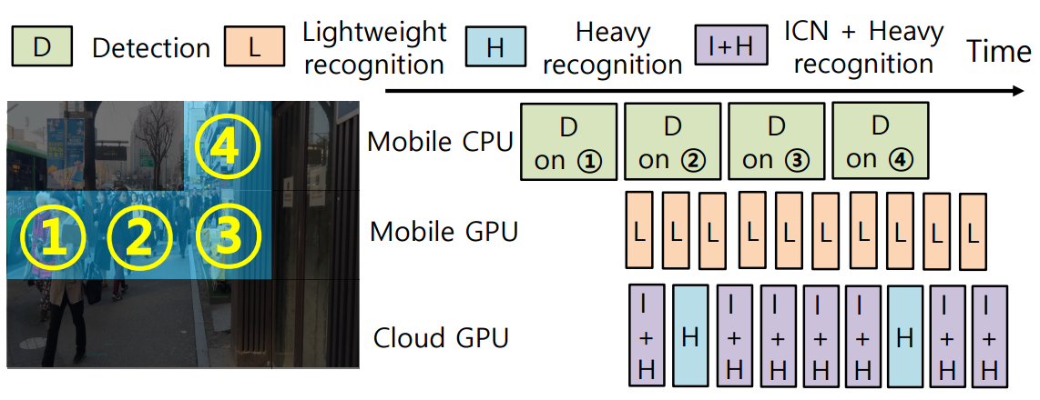
Spatial Pipelining
Divide image into blocks and pipeline the execution on mobile CPU & GPU, and cloud GPU

Slide 31
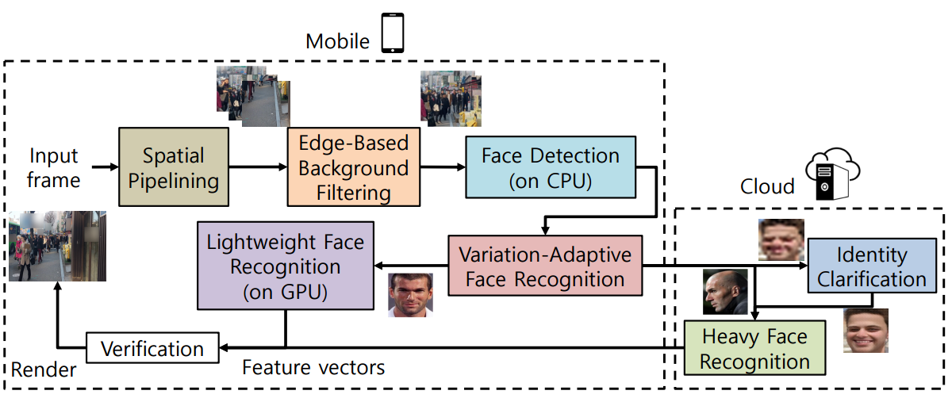
Putting Things Together

Slide 32
Key Evaluation Results
Result on a scene with 20 faces (hard/easy faces mixed)
The gap increases with more crowded scenes
9.26x

Slide 33
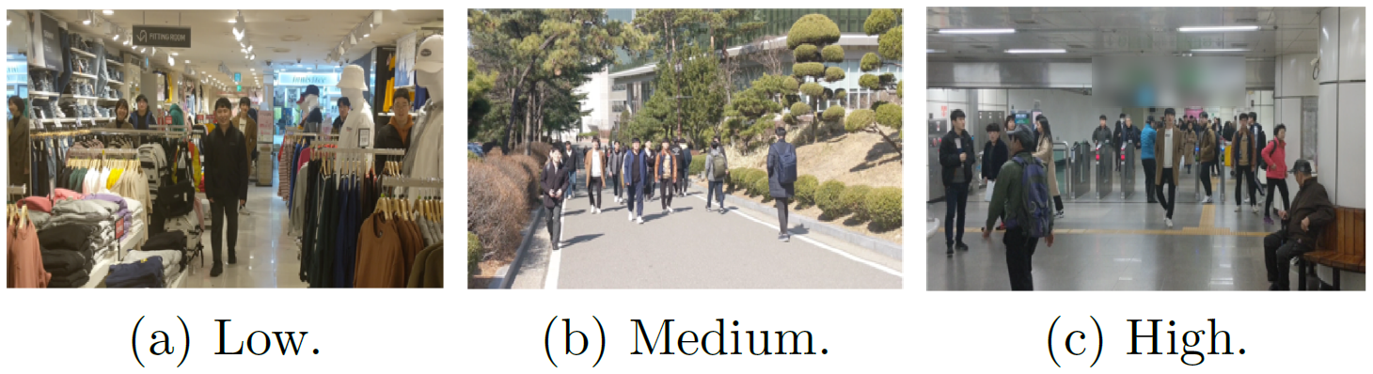
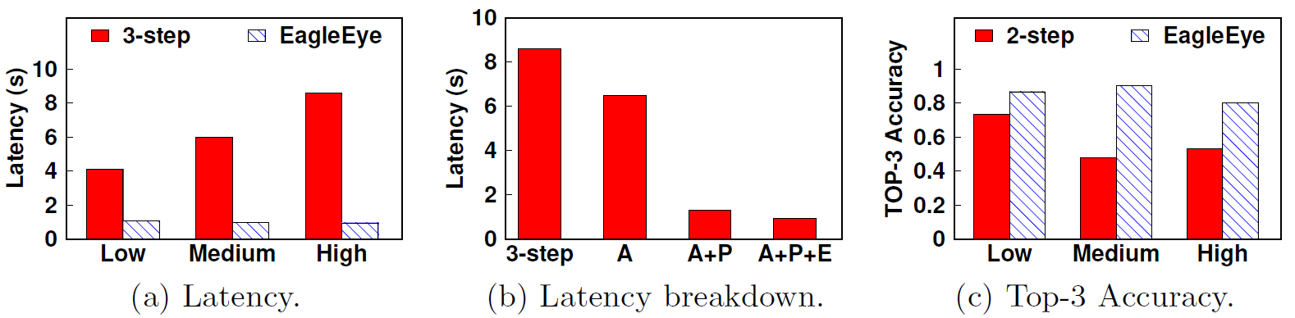
Key Evaluation Results
Results on scenes with diverse crowdedness
(A: Adaptive recognition, P: Spatial pipelining, E: Edge-based background filtering)

Slide 34
Summary
We present EagleEye, an AR-based person identification system on mobile for crowded urban spaces
Identity-Clarification Network for LR face recognition
Utilize reference images to fine-tune the network
78% TP increase at the cost of 14% FP
Multi-DNN Content-Adaptive Parallel Execution for multi-DNN execution
946 ms latency (9.07x gain over baseline in crowded scenes)
Generalizable to various multi-DNN-enabled applications

Slide 35

!
Thank you for your attention

